Slide 1

Senalingua
Karen Castañeda, Andres Felipe, Emanuel, Karen Pastas, Cristian Yalanda, Erik Santiago Alegria

Slide 2
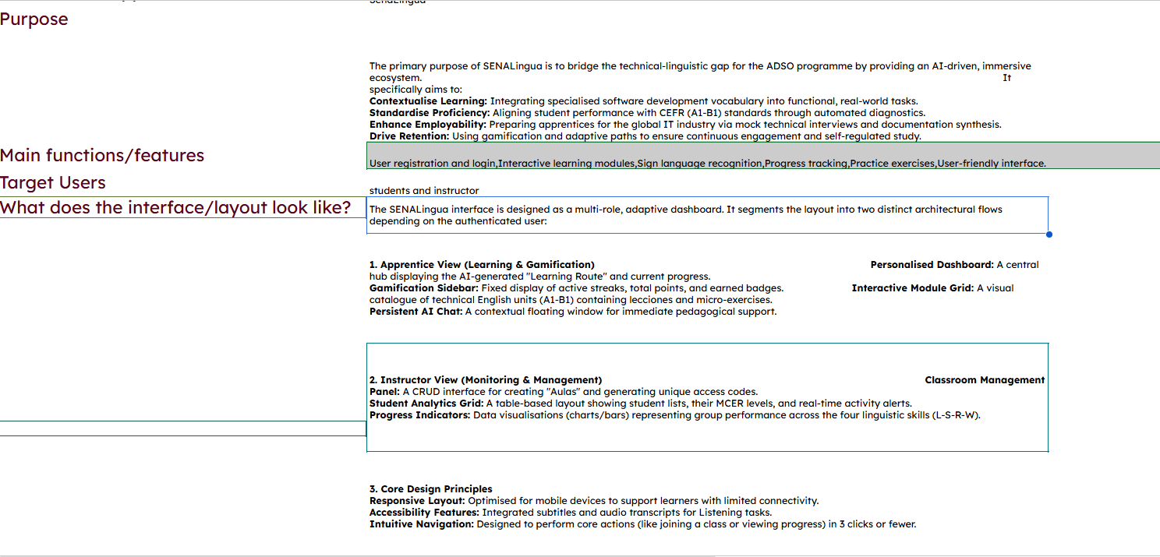
Software Projects Description

Slide 3
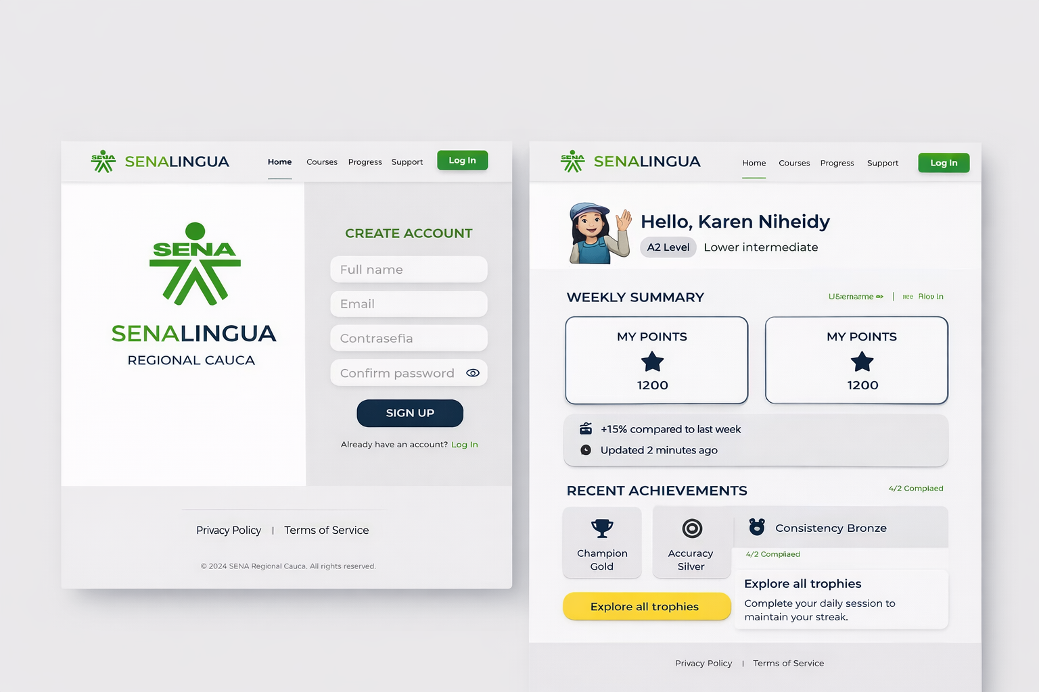
Website Interface

Slide 4
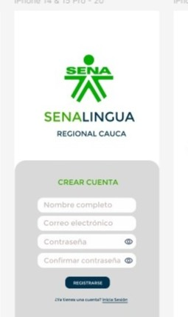
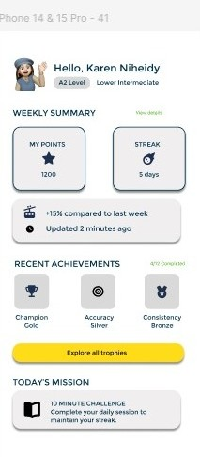
Mobile App

